Slide 1
29th May 2024

Slide 2
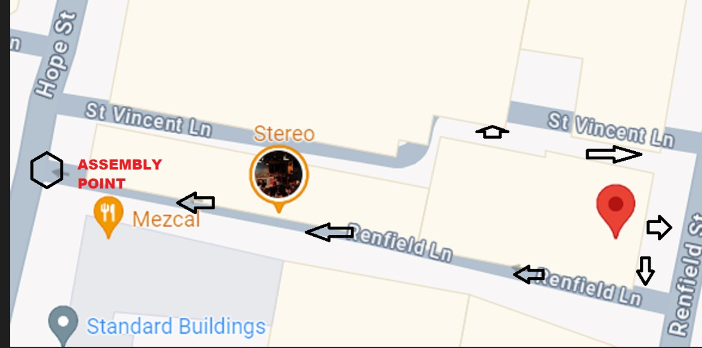
Housekeeping
No scheduled fire alarm today, nearest exit/ assembly point
Guest Wifi – CAS Guest, password – caswireless
Break at 11:20
Toilets

Slide 3
Agenda
10.00 – 10.10 | Introduction Actions from January meeting | Natasha Gilmour Citizens Advice Scotland Suzi Cassie, EHU Citizens Advice Scotland
10.10 – 10.30 | Consumer Service Operations update | Leanne Dullard, Citizens Advice
10.30 - 10.45 | Advice Direct Scotland Operations update | Hazel Knowles, Advice Direct Scotland
10.45 – 11.20 | Extra Help Unit Operations update Trends and concerns from Q4 | Natasha Gilmour George Holmes Andrew Bayne Angus McMillan, EHU Citizens Advice Scotland
11.20 – 11.30 | Break

Slide 4
11.30 – 11.45 | Discussion: Industry processes that are slowing case resolutions. Will be conducted in two groups – one online and one in Portland House. | All participants, following introduction from Angus McMillan
11.45 – 12.00 | Citizens Advice Energy Policy Team, Energy policy update | Will Johnstone, Citizens Advice
12.00 – 12.15 | Consumer Scotland Update | Michael O’Brien, Consumer Scotland
12.15 – 12.30 | AOB & Next meeting dates | Natasha Gilmour, Citizens Advice Scotland

Slide 5
Citizens Advice consumer service – Update
May 2024
Citizens Advice

Slide 6
Codes changes as of April 1 2024
Following on from the codes changes that were implemented in January 2024, we have completed a second round of minor code changes, working alongside the EHU and ADS.
Confirmation of the changes can be found below:
Newly implemented codes

Slide 7
Codes removed as of April 1 2024
Removed codes
These codes were removed to reduce duplication and splitting the volume of cases.
These were originally added to allow for detail of data on specific cases but it diluted the total number of cases in some key areas

Slide 8
Codes renamed as of April 1 2024
Renamed codes
Code ID | Code Title | Description
DD02 | Debt recovery practices | Debt Recovery Practices (PPM Not Threatened) - Communication or engagement with supplier in relation to debt is causing the consumer concern or stress - however there does not appear to be an imminent risk of a prepayment meter being fitted.Unsuitable repayment arrangements should be coded under DD10. This does not include bad practices by administrators, in which case use FS2.
DT04 | Difficulty or delay in obtaining connection / alteration of supply | Issue with New Connection or Alteration of Supply - This is to capture when a consumer is trying to arrange for a new connection or alteration to their connection with the Network Operator, or is unhappy with a recent connection or alteration made to their supply

Slide 9
Performance - Quarter 4
31%
Reduction in total demand when compared to Q4 22/23
25%
Reduction in demand for the priority line compared to Q4 22/23
95%
Clients were satisfied or very satisfied with the consumer service

Slide 10
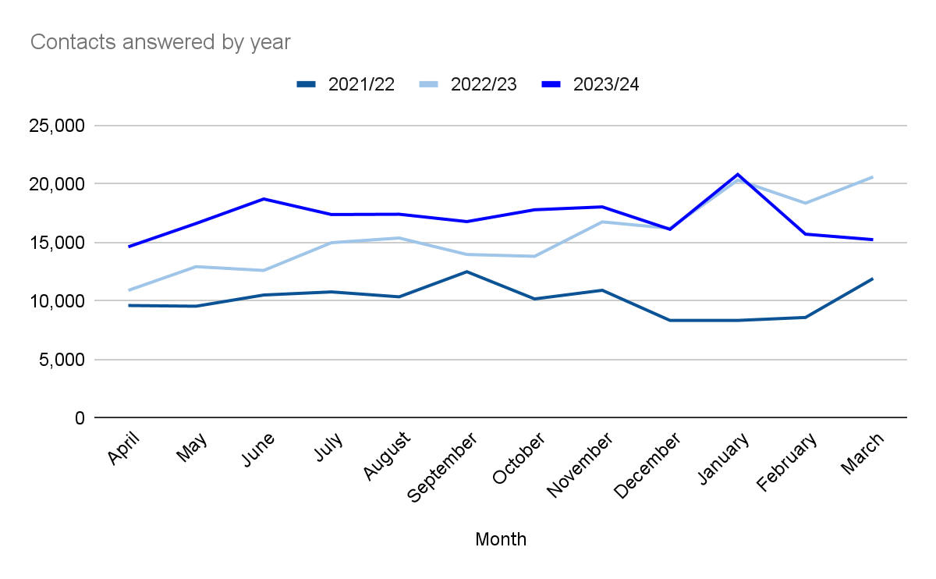
Contact volumes comparison 2021/22 to 2023/24

Slide 11
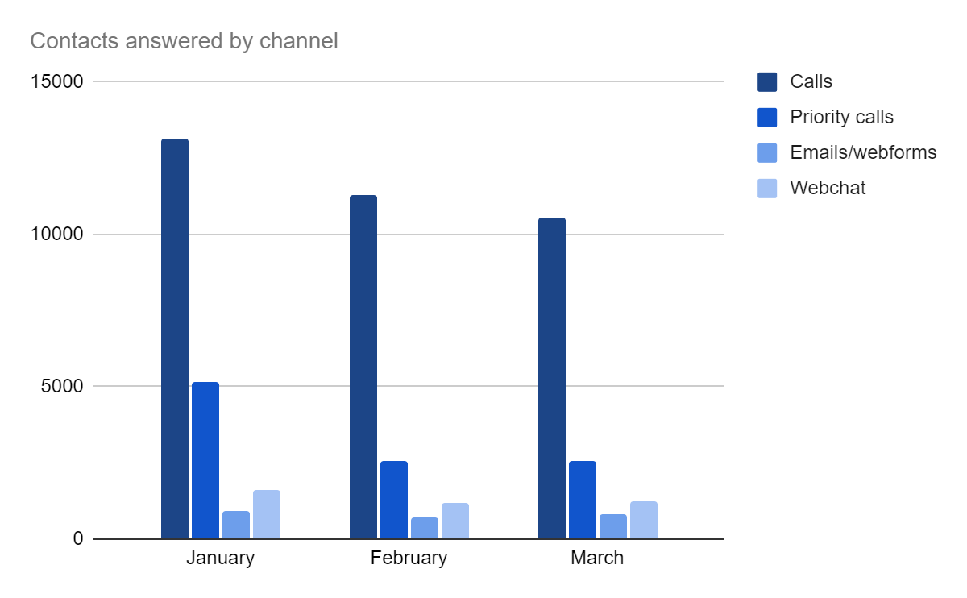
Quarter 4 contacts answered by channel

Slide 12
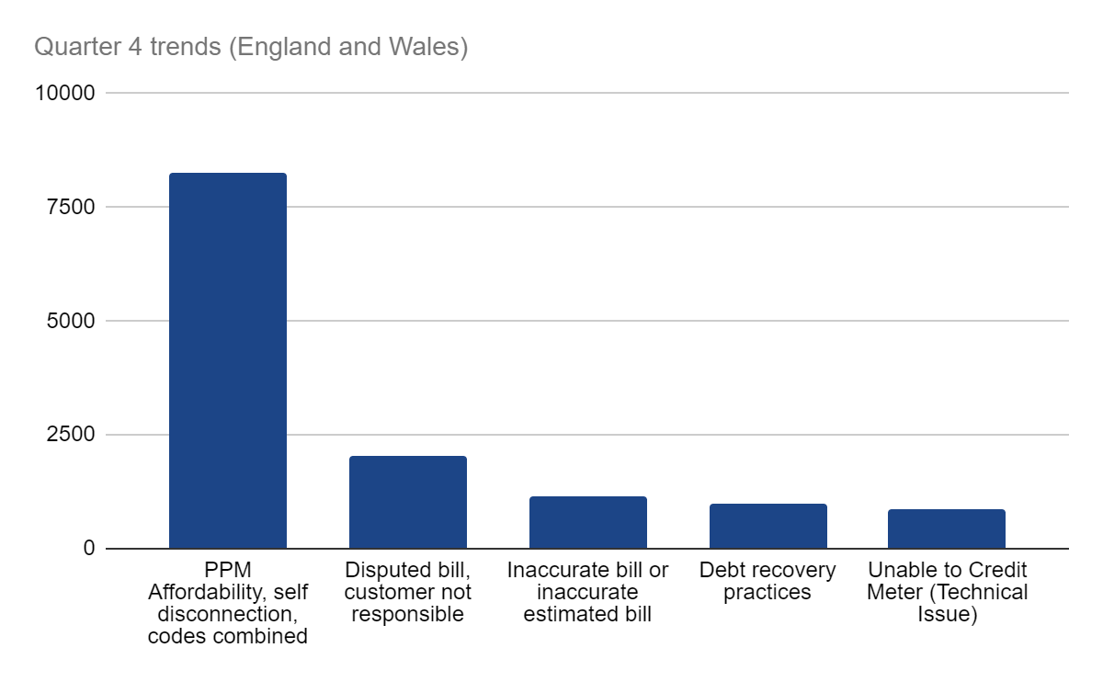
Trends quarter 4 2023/24

Slide 13
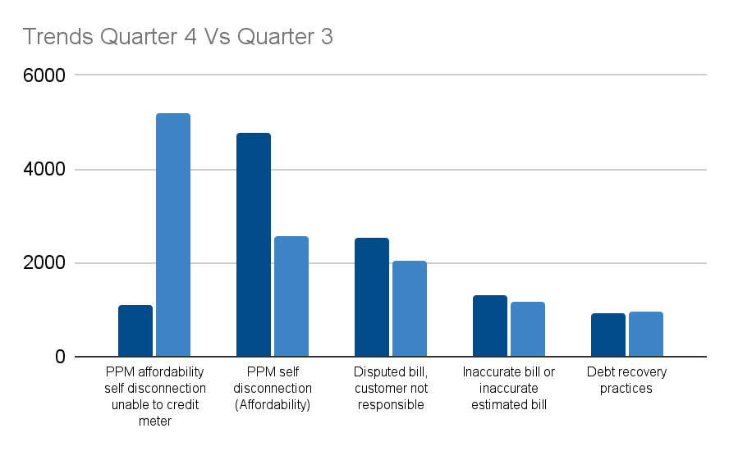
Trends Quarter 4 vs Quarter 3 2023/24

Slide 14
Quarter 4 Trends split by nation
England
PPM self disconnection (Affordability) | 4497
Disputed bill, customer not responsible | 2403
Inaccurate bill or inaccurate estimated bill | 1253
PPM affordability self disconnection unable to credit meter | 1050
PPM affordability: topping up causing financial detriment | 1006
Debt recovery practices (PPM not threatened) | 892
Catch up bill received | 621
Meter accuracy | 579
Unable to Credit Meter (Technical Issue) | 529
Direct debit issues | 528
Wales
PPM self disconnection (Affordability) | 270
Disputed bill, customer not responsible | 139
Inaccurate bill or inaccurate estimated bill | 56
PPM affordability: topping up causing financial detriment | 51
PPM affordability self disconnection unable to credit meter | 51
Debt recovery practices (PPM not threatened) | 43
Unable to Credit Meter (Technical Issue) | 38
Warm Home Discount | 31
Price/tariff information | 28
Direct debit issues | 28

Slide 15
Signposted cases
Signposted to | Total signposts
Citizens Advice local office | 8,967
Energy Ombudsman | 706
National Debtline | 1066
Ofgem | 616
Shelter | 822
Fuel Voucher Signpost | 217

Slide 16
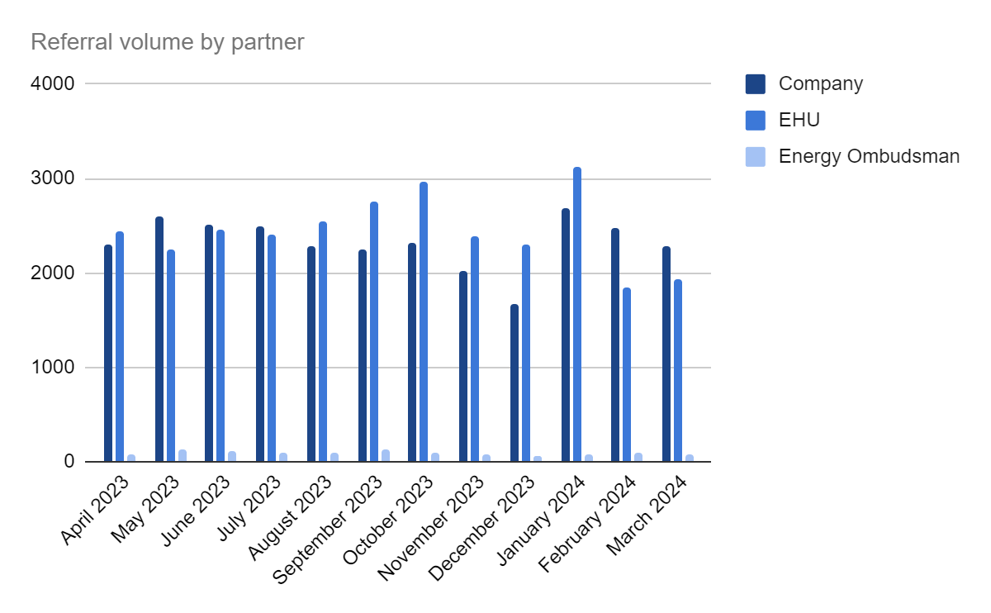
Referral proportions 2023/24

Slide 17
Presented by: Leanne Dullard
Date: 29 May 2024

Slide 18
Advice Direct Scotland
Domestic Supplier Liaison Quarter 4 2023/24
Hazel Knowles
Senior Project Lead
hazel.knowles@advice.scot

Slide 19
Key Points from Q4
Self-Disconnection
Self-disconnection cases were high throughout Q4, ADS received a higher volume of self-disconnection calls in Q3 and Q4 than in the previous year at the peak of the energy crisis. This points strongly to associated consequences of high energy debt
Home Heating Support Fund
The final count of awards in the last year of the fund was £8,381,492.
This included £1,104,515 in prepayment vouchers.
Net Zero Issues
We have seen crossover across our energy and consumers services in issues relating to net zero. Concerns around MCS certification and claiming of SEG scheme as well as customer understanding of correct energy tariffs. This is an area we will focus on for training and policy in future.

Slide 20
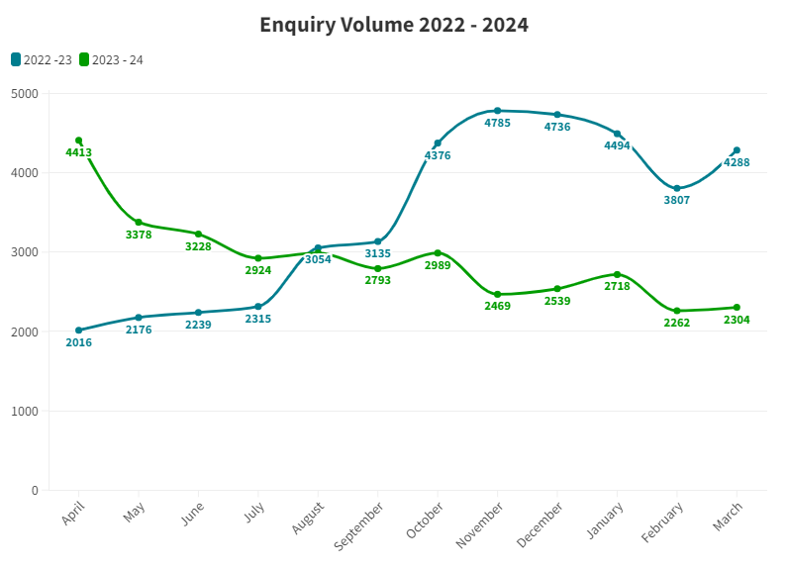

Slide 21
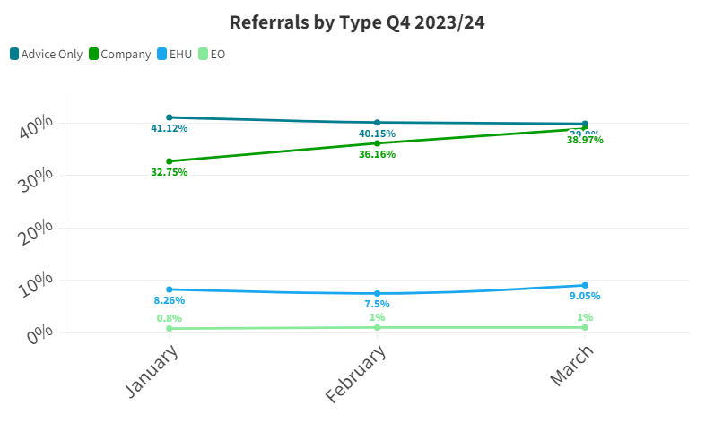

Slide 22
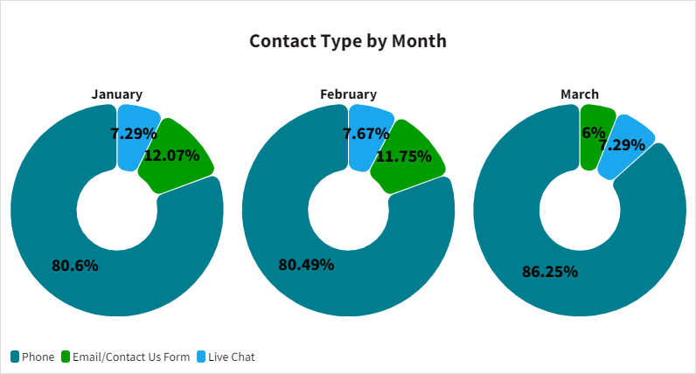

Slide 23
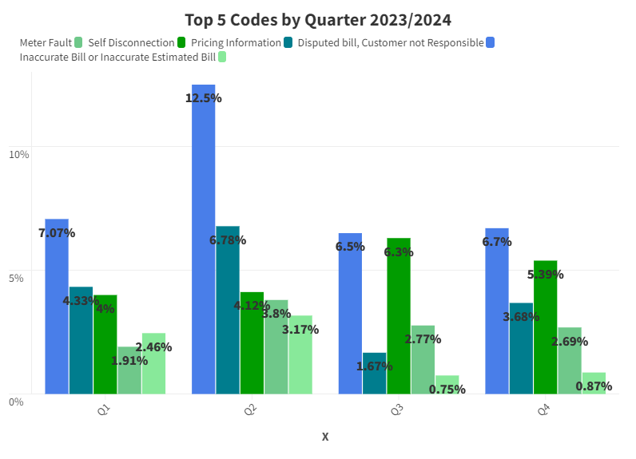

Slide 24
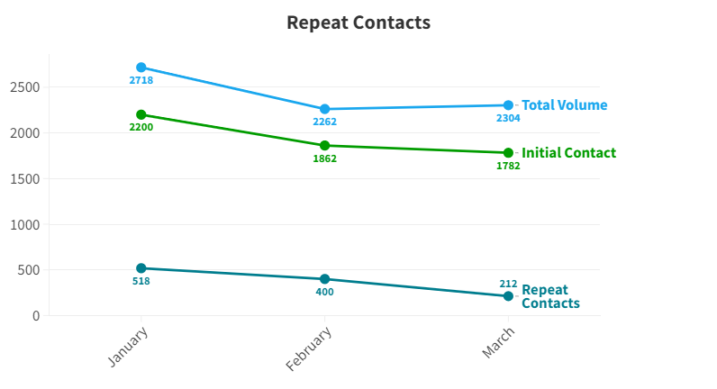

Slide 25
Social Tariff Campaign
Calling for a social tariff alongside charities, consumer groups.
“Opt-out” tariff to avoid issues faced by telecoms industry
Gas equivalent to support those in rural areas or housing without gas access
Targeted support for low-income customers
Targeted support for those with high energy use i.e. medical requirement for a warm home

Slide 26
Social Tariff Survey
Survey Highlights
Survey of 1043 Scots aged 16+
57% were worried about being able to afford energy bills over the next 12 months
51% had limited energy use to pay for other essentials, 25% had significantly limited their use
50% had sometimes been cold in their home due to energy rationing, 24% had often been cold
Of those surveyed 14% had more than £1000 of energy debt
33% of prepayment customers had sometimes self-disconnected due to affordability, 24% had often self-disconnected
66% were supportive of a social tariff

Slide 27
Consumer Scotland
As we continue to strengthen our relationship with Consumer Scotland, we have established a quarterly policy forum.
Membership of Energy Consumers Network and Rural Energy Working Group.
Ovo
Worked alongside Ovo to deliver a support event in Glasgow.
Event was highly successful and allowed us to assist with a range of concerns, not just energy but also welfare and debt issues.

Slide 28
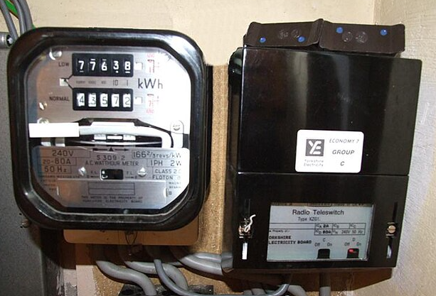
RTS
Concern over customer journeys for RTS switch off
Information sheet putting onus on customers to contact their supplier.
Known delays and challenges in supplying remote and island customers with smart meters.
Customers contacting through general support lines not likely to get an agent familiar with RTS.
We would like to see a proactive approach from suppliers in identifying and supporting RTS customers.

Slide 29
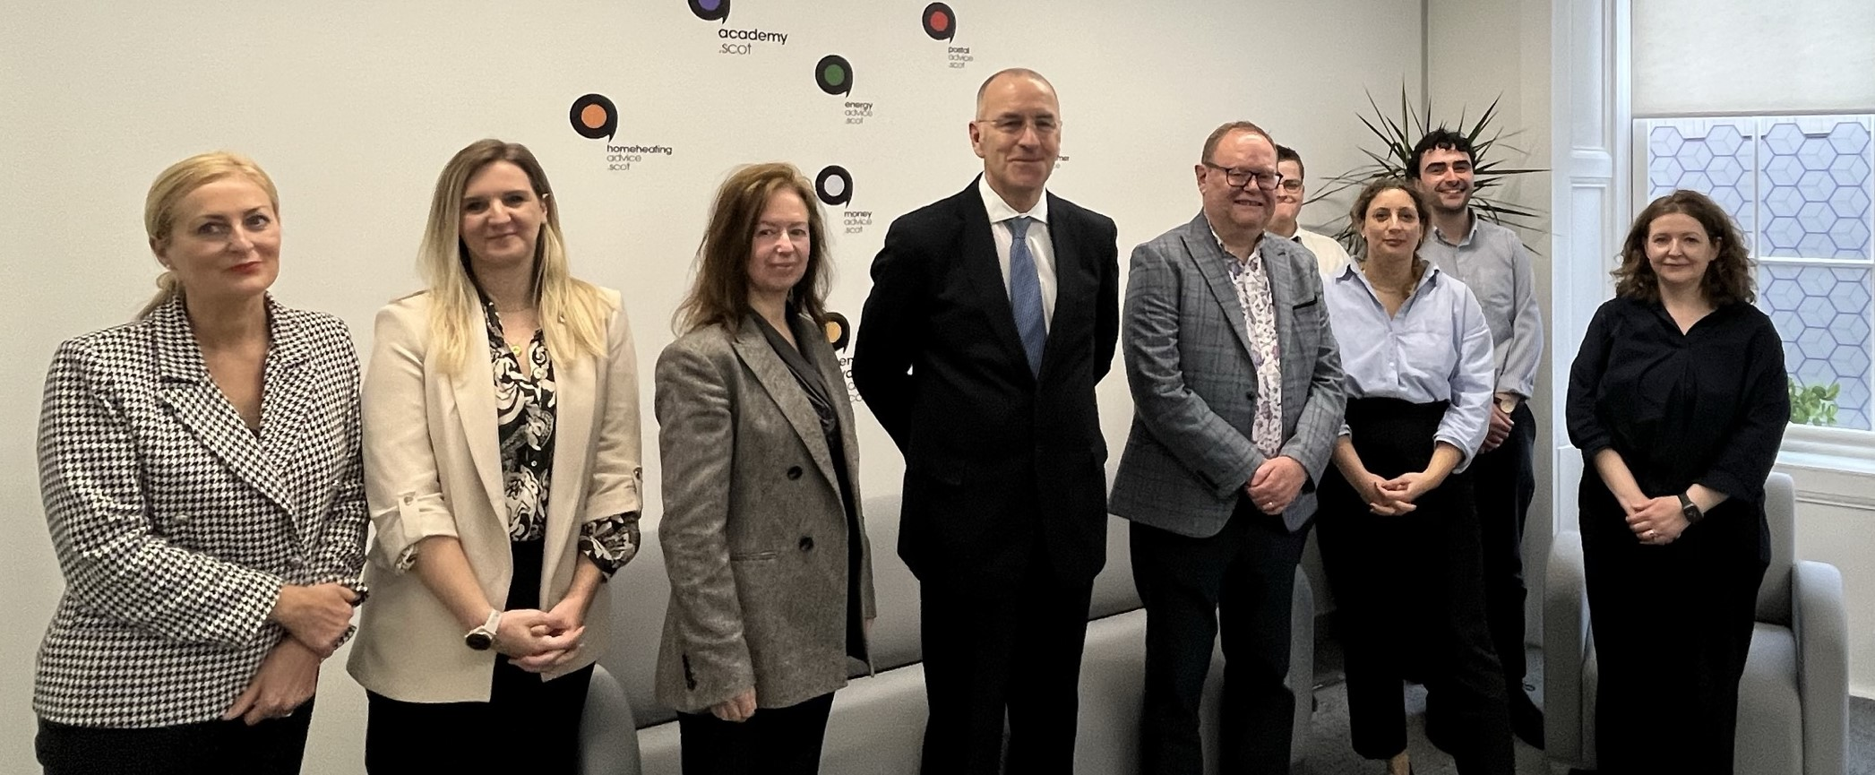
Ofgem Board Visit
We welcomed senior Ofgem staff, including their Chair and Chief Operating Officer, to our offices for a roundtable discussion on topics such as:
Legislative concerns impacting Advice Direct Scotland
Our role in the energy landscape
Issues affecting Scottish customers

Slide 30
Areas of Focus Q4
Debt and Affordability
We will continue to focus on debt and affordability, as well as responding to recent consultations, we are ensuring our teams are available to support customers struggling to meet costs.
Gas Standing Charge Campaign
We will be running a campaign throughout the summer to draw awareness to gas standing charges, as we often see customers struggling with debt build up on their gas meters after the summer months.

Slide 31
Supplier Liaison Update
The help I received from EHU was like meeting a long lost friend who actually cares
29th May 2024 Natasha Gilmour, Angus McMillan,
George Holmes, Andy Bayne

Slide 33
Casework Volumes Q4 23/24
96% of cases domestic
71% of complaints involve self disconnection
All Complaints
Down by 13%
Priority complaints down by 16%
Complex Complaints up by 0.4%
Self Disconnection down by 15%
Ask the Adviser down by 13%
All Enquiries down by 5%
Notes:
Visual representation of changing composition of complaints/proportions that are urgent and proportion that are complex
All Enquiry types up by 15%

Slide 34
Header
Area | KPI 23/24 | Q1-Q4 23/24 | Q4 23/24 | Q3 23/24 | Q2 23/24 | Q1 23/24
Responding to Complaints | 95% of priority complaints are raised with supplier within 48 hours of case being received | 95% | 96% | 96% | 95% * Issues with reporting | 94% *Issues with reporting
 | 90% of complex complaints raised with supplier within 20 days of case being received (from Q2) | 93% | 92% | 92% | 94%
Case Resolution Timescales | 75% of domestic priority complaints resolved within 28 days | 89% | 94% | 83% | 91% | 86%
 | 70% of domestic complaints resolved within 85 days | 90% | 92% | 93% | 89% | 84%
Positive Outcomes | 95% of domestic complaints resolved with a positive outcome/change | 96% | 96% | 96% | 95% | 95.5%
Quality Assurance | 90% of cases checked meet the required quality standards | 93% | 93% | 94% | 92% | 92%
Customer Satisfaction | 85% of Domestic consumers surveyed satisfied or very satisfied with overall quality of service 80% of domestic consumers surveyed satisfied with outcome achieved | 95% 89% | 95% 90% | 96% 90% | 96% 89% | 95% 88%
Staff Morale | 75% of staff describing their current mental health and wellbeing as satisfactory - twice yearly 75% of staff reporting they have a good sense of achievement from the work they do – twice yearly | 83% 91% | 86% 96% |  | 80% 86%
KPIs 23/24
“Problem solved within days, with efficiency and sympathy and understanding. Without the help of the EHU I would be in a dreadful state emotionally and financially” Accent Research May 2024

Slide 35
Accent Customer Research
cases closed December, January and February
Outcomes and measures Q4 23/24
93% happy with referral process
89% satisfied with outcome
95% happy with time taken to resolve case
71% felt less alone
74% felt less stressed after EHU support
60% felt their mental health and well being improved after support
83% felt EHU helped them find a way forward
Financial redress
£1,742,369
Fuel Bank Foundation Partnership
16 fuel vouchers totalling £1363
Answered 96% of calls totalling 18677
I’ve never had help like it. It was bish bash bosh.
It’s the most helpful anyone’s ever been with me.” Accent Report December 2023

Slide 36
Q4 24/25
Q1-Q4 24/25
Top Codes:
42% benefits check
38% Grants/Trust funds
105 people helped
£20,169
potential financial gain
842 people helped
81k potential financial gain

Slide 37
Referral Partners – Across the nations

Slide 38
23/24 Summary
Complaints
34,853
Up 1.5%
Enquiries
3,632
down by 7.5%
Ask the Adviser
1,197
Down by 26%
Financial Redress
£6,142,170 up by 114%
Calls answered 77406
up 5%

Slide 39
24/25 KPIs
Responding to priority complaints | 95% of priority complaints are raised with supplier within 48 hours of being received
Responding to complex complaints | 90% of complex complaints raised with supplier within 15 days of being received
Case resolution timescales for domestic complex complaints | 80% of domestic complex complaints resolved within 85 days
Case resolution timescales for priority complaints | 75% of domestic priority complaints resolved within 28 days
Quality Assurance | 90% of cases checked meeting required quality standards
Delivering Positive outcomes | 95% of domestic complaints resolved with a positive outcome/change
Staff morale and well-being | 75% of staff describing their current mental health and wellbeing as satisfactory 75% of staff reporting they have a good sense of achievement from the work they do

Slide 40
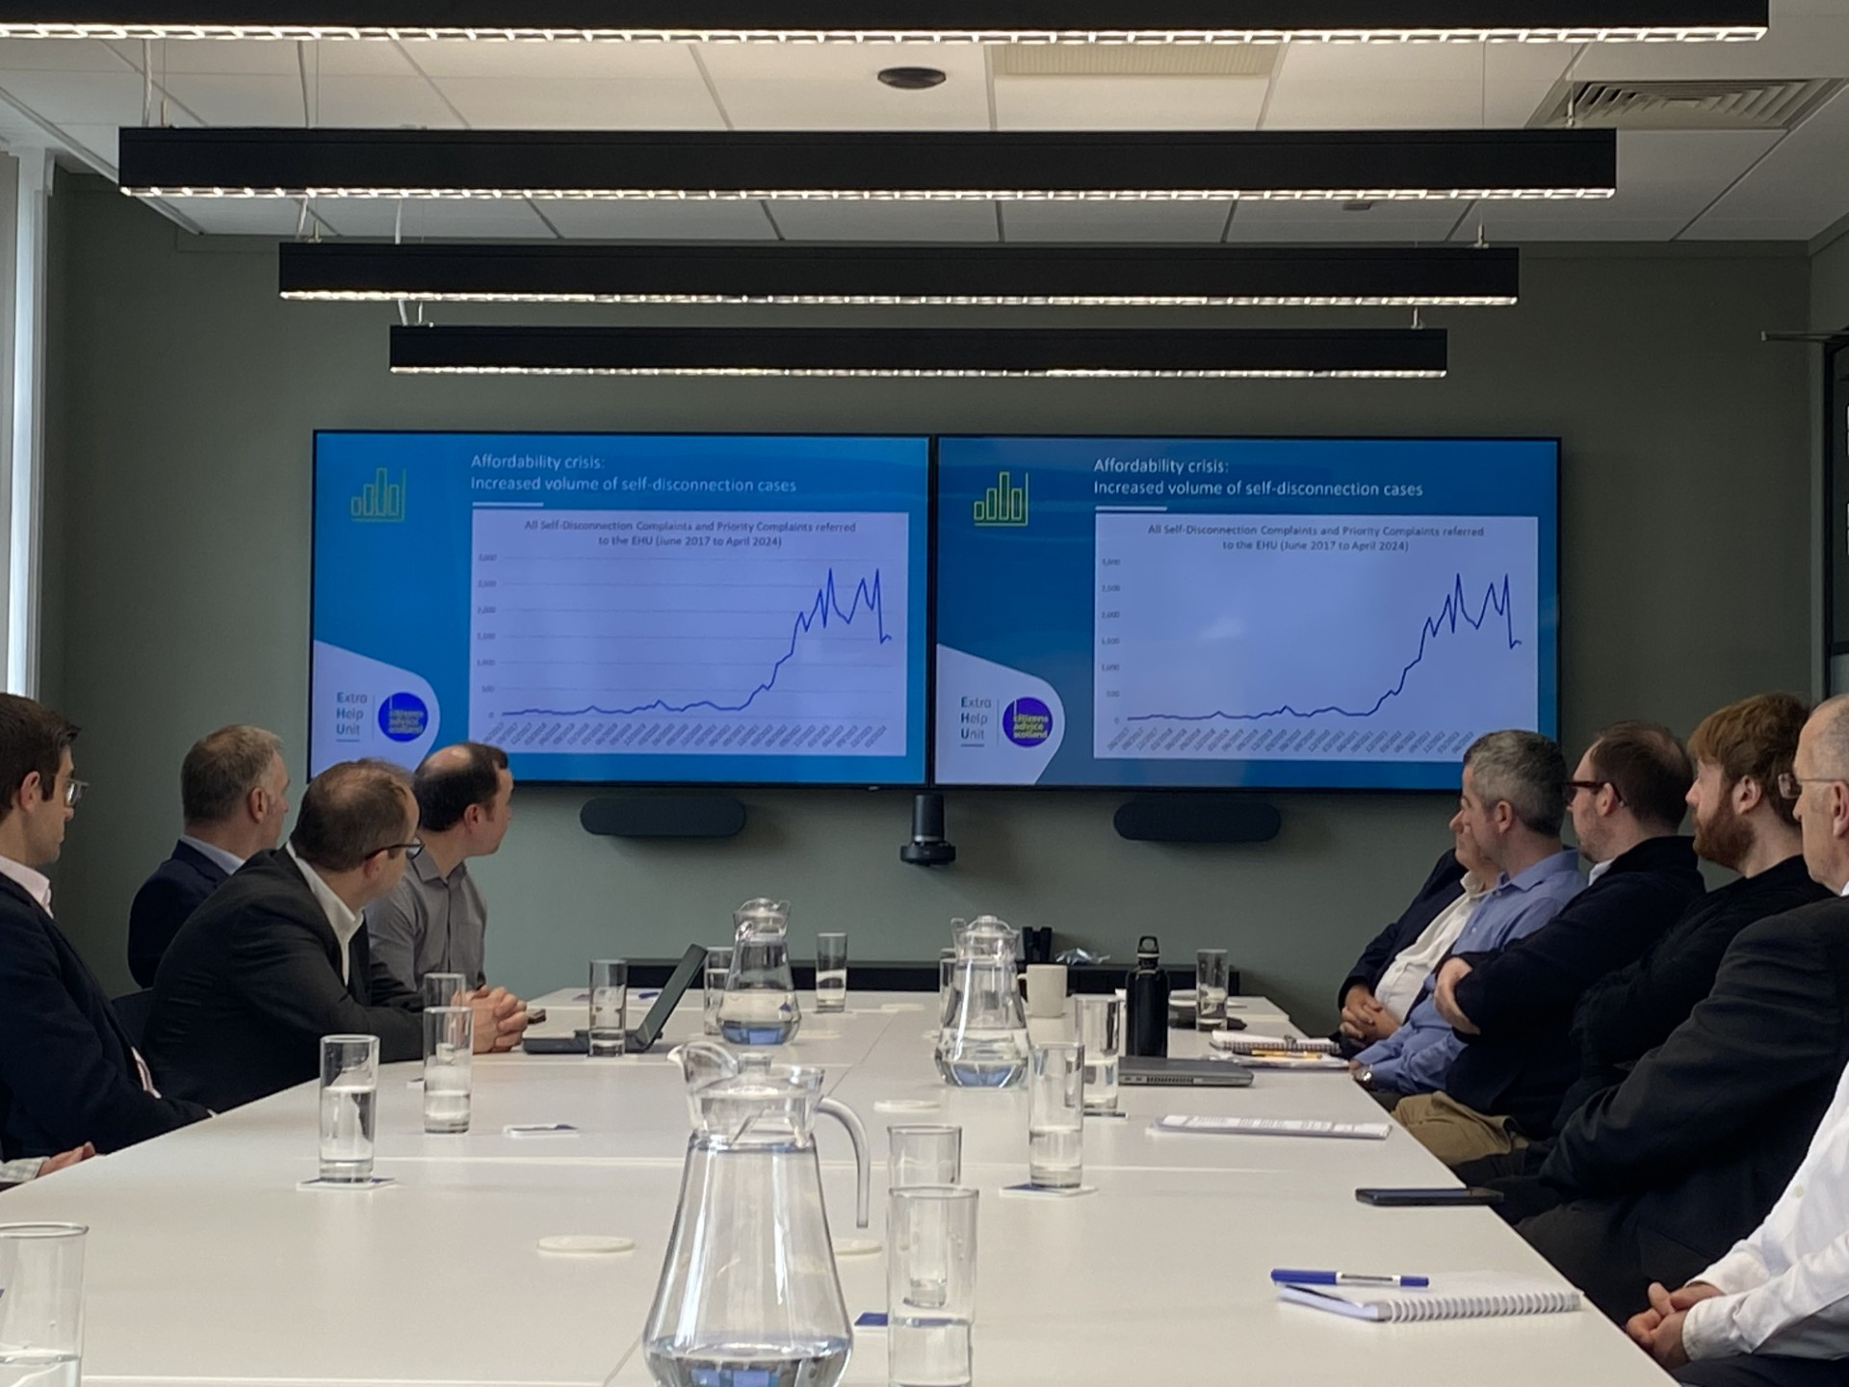
Operational Update 23/24
Successes
Shortlisted for:
Energy Champion of the Year Group Achievement
Resources
1 leaver and in process of starting 2 secondments from industry
Training
2x Gin Lalli sessions - How to empty your stress bucket. Solution focused therapy to help with resilience and anxiety
Team Manager training course on Managing Performance (external)
Vulnerability refresher session (internal)
Multi Agency Approach to Safeguarding conference (managers)
Working in Partnership
Welcomed chair and board of Ofgem to EHU and held a session with Caseworkers
Training delivered to ADS agents to ensure smooth referral pathway and clear access to EHU

Slide 41
Safeguarding
“They probably saved my sanity. It was purely because of them that I managed to carry on” Accent May 2024”

Slide 42
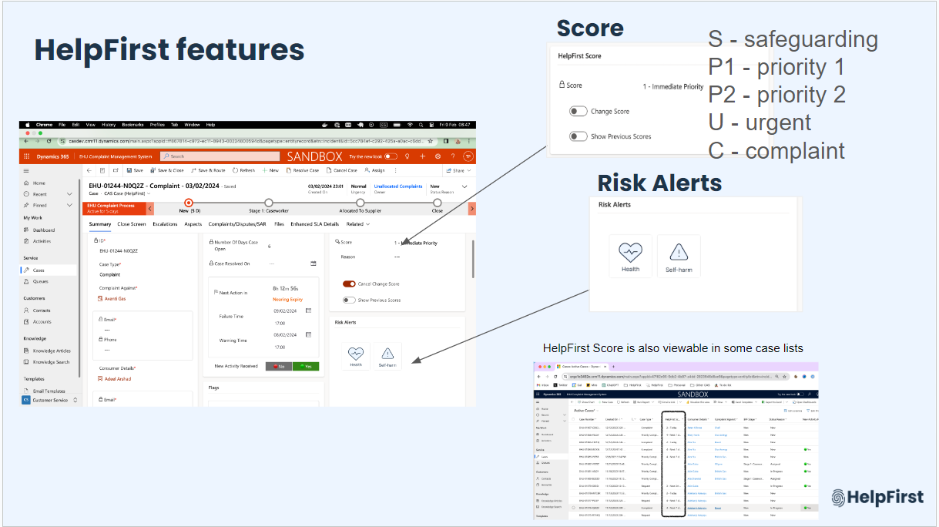
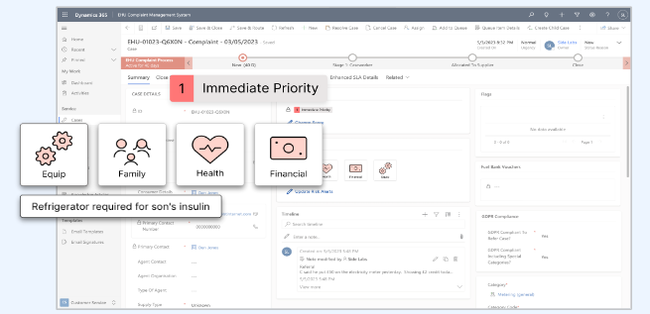
Development of Services - HelpFirst & Portal
Supplier Portal Progress

Slide 43
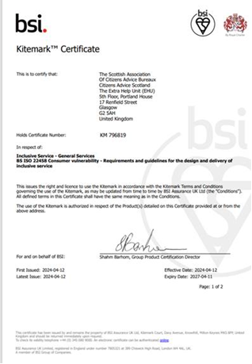
Development of Services
BS ISO22458 Kitemark certificate for Inclusive Service
The Extra Help Unit previously held the British Standard for inclusive service provision. In early 2024, following a further extensive audit process, we were successful in upgrading to the new ISO standard.
In practice it means that the service has been recognised as supporting vulnerable consumers in a flexible, accessible and inclusive way.

Slide 44
Top 8 category codes Q4 | England | Scotland | Wales | GB Total Q4 | % change from Q3
PPM Self Disconnection /Affordability | 5,005 | 551 | 247 | 5,827 | Down 15%
Unable to Credit Meter PPM (Technical Fault) | 278 | 32 | 26 | 339 | Down 37%
Disputes bill, customer not responsible | 249 | 12 | 19 | 283 | Up 30%
Inaccurate bill or inaccurate estimated bill | 135 | 7 | 5 | 150 | Down 3%
Meter provision or exchange | 93 | 4 | 10 | 108 | Up 17%
Debt Recovery Practices (PPM Not Threatened) | 95 | 0 | 8 | 103 | Down 20%
Supply point administration query (MPRN/MPR/MPAS) | 90 | 3 | 2 | 95 | Up 32%
Unaffordable payment plan offered | 88 | 1 | 4 | 94 | Down 3%
Referral Trends Q4 2023/24
Key year on year changes:
174% increase in 'Disputes bill, customer not responsible' cases compared to Q4 2022/23 when 103 cases were logged.
16% decrease in self-disconnection cases compared to Q4 2022/23 when 6,977 cases were logged.

Slide 45
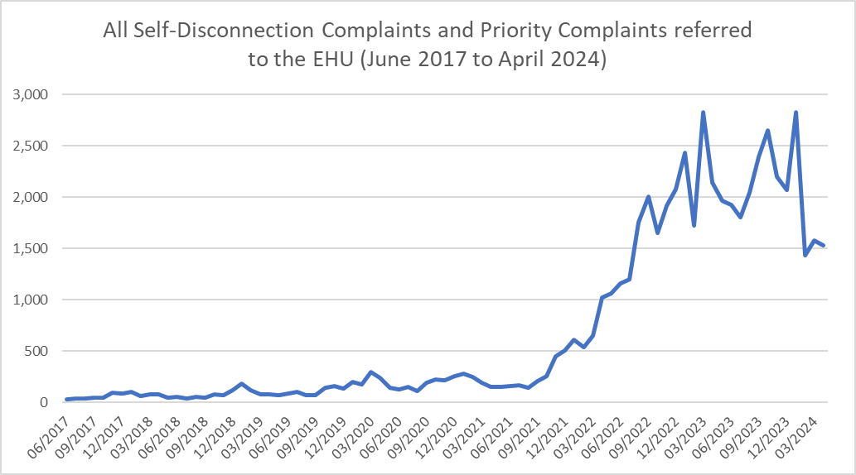
Affordability crisis:
Increased volume of self-disconnection cases

Slide 46
Cross sector analysis
Supplier Performance Leads to spend more time each quarter analysing cohorts of related category codes across all suppliers
Intended to allow more direct comparison of performance and policies between suppliers
Cases analysed will be shared with suppliers for comment
Following supplier engagement the spreadsheets will be shared with Ofgem

Slide 47
Working Together
Tracking escalations as a measurement of performance
Priority process – introduced change to a single process with all priorities being emailed to suppliers initially from 20th May
Importance of maintaining phone access for complex cases
Consultation on the Process for disputing complaints – response delayed as we better understand the changing complaint volumes and drivers for these, plus technical changes required to progress

Slide 48
Questions?

Slide 49
Discussion: Industry processes that are slowing case resolutions.
 | Age range comparison of Allocated To Supplier (BPF Stage) cases 3rd May 2024
Age Range (days open) | 0 - 49 | 50 - 99 | 100 - 149 | 150 - 199 | 200 - 249 | 250 - 299 | 300 - 349 | 350 - 399 | 400 - 449 | 450 - 499 | 500 - 549 | 550 - 599 | 600+ | Grand Total
Volume of cases | 941 | 435 | 193 | 134 | 70 | 34 | 18 | 15 | 11 | 4 | 2 | 2 | 4 | 1,863
In recent years we have noted that a relatively small but concerning number of cases are taking much longer to resolve:
Ongoing problems with commissioning smart meters
Difficulty arranging metering appointments
Time to resolve meter registration issues, especially those involving multiple suppliers
Intention to work with other stakeholders to advocate for improved processes in these areas. Where do you think the main pain points are?

Slide 50
Energy Team Update
Supplier Liaison Meeting 29th May 2024

Slide 51
Contents
Publications, blogs and consultation responses
Team updates
Energy Retail Markets
Net Zero Homes
Energy Network and Systems
Notes:
51

Slide 52
Recent publications
Shock Proof: Breaking the cycle of winter energy crises
The debt protection gap
Don’t settle for second best: Ensuring energy market reforms stack up for people
Notes:
52

Slide 53
Recent Blogs
A Foamidable Challenge - Spray Foam Insulation: Breaking Down the Risks
Zero Guarantee? Net Zero homes need better financial protections
Essential Services, Essential Oversight: Building a better regulatory framework to protect those who need it the most
Essential Services, Essential Oversight: The one thing that has to change to ensure the grid we need is delivered
It’s time to bring households off the gas grid in from the cold

Slide 54
Consultation Responses
We have responded to the Ofgem consultation about an additional debt-related costs allowance in the default tariff cap, the consultation on strengthening the economic regulation of the energy, water and telecoms sectors, and to the DESNZ consultation on proposed modifications to Sizewell C Limited’s electricity generation licence in order to implement the Regulated Asset Base (‘RAB’) model.
We also responded to the Ofgem call for input on data sharing in a digital future: consumer consent, to Ofgem’s non-domestic market review: Statutory consultation on licence changes, and to the Ofgem consultation on the policy direction for the Future System Operator’s regulatory framework.
We responded to Ofgem’s Call for Input on standing charges, to the UK Regulators’ Network Strategy 2024-27 Public consultation and to the Ofgem consultation on the Market Facilitator Delivery Body.

Slide 55
Consultation Responses
We responded to CCW’s Draft Strategy and Forward Work Programme 2024-25, Ofgem’s Forward Work Programme – 2024/25, and ESNZ Committee’s Inquiry on energy bills for domestic customers.
We also responded to DESNZ Consultation Response: a new threshold for businesses accessing the Energy Ombudsman, the Consumer Scotland consultation on the Draft Work Programme 2024-25, and the DESNZ consultation on heat network zoning.
We have responded to RIIO-3 Sector Specific Methodology for the Gas Distribution, Gas Transmission and Electricity Transmission Sectors, the Ofgem consultation on amendments to the RIIO-ED2 Major Connections Governance Document, and Ofgem’s call for input on a Future Regulation Sandbox.

Slide 56
Consultation Responses
We wrote a Letter to the Secretary of State for Energy Security and Net Zero - Urgent review of net zero consumer protections.
We responded to DESNZ call for evidence on the future of default tariffs, to consultations on code reform implementation and code manager licencing, and to Ofgem’s call for input on AI within the energy sector.

Slide 57
Energy Retail Markets Team: updates
Current policy/advocacy work
We published Get Smarter, a report which used nationally representative polling to investigate common issues with smart meters and call for enhanced consumer protections.
We published a report on the debt protection gap, highlighting the increase in harmful debt collection practices.
We are continuing our enhanced monitoring on forced PPM installations, reviewing all cases on a weekly basis.
Coming soon
Responses to consultations on removing the ban on acquisition-only tariffs and the supplier Guaranteed Standards of Performance payments inflation uplift

Slide 58
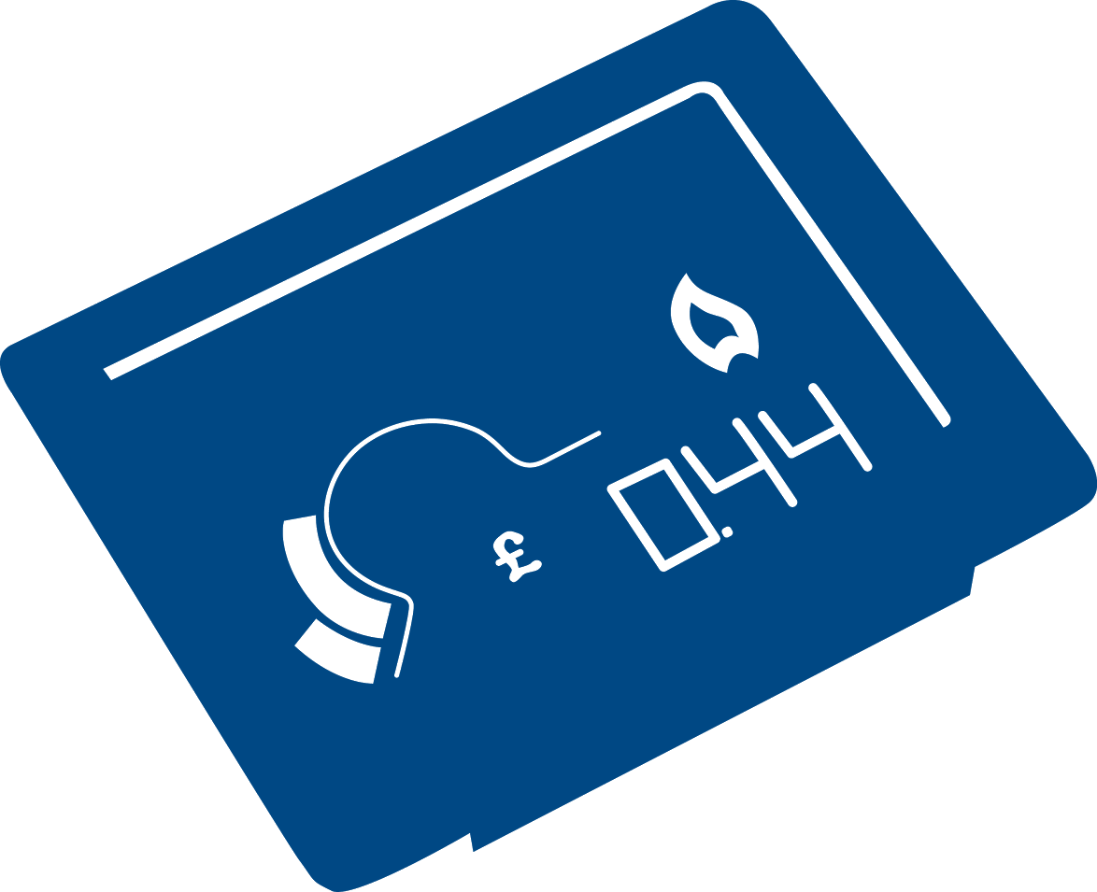
Net Zero Homes: updates
Current policy/advocacy work
We published Don’t settle for second best, a report on how to make sure that net zero energy market reforms stack up for consumers
We wrote to the Secretary of State to urge the Department for Energy Security and Net Zero to urgently review consumer protections for anyone carrying out green upgrades to their home
We published blogs on complaints around spray foam insulation and the need for financial protections for low carbon heat technologies
Coming soon
Response to a consultation on delivering a smart and secure energy system
Report on consumer experiences of redress under Government energy efficiency schemes

Slide 59
Energy Networks & Systems Team: updates
Current policy/advocacy work
Ongoing work regarding the Review of Electricity Market Arrangements, including co-facilitating the End User Challenge Panel
Published a blog on the need for reform to regulatory appeals
Developing a strategic partnership with the National Energy System Operator to ensure consumer interests are central to the energy transition
Coming soon
Beginning research into the effectiveness of Innovation spending funded through consumer bills
Publication of research into ensuring Community Benefits for hosting energy infrastructure represent good value for money for consumers generally

Slide 60
Consumer Scotland - Policy Update Supplier Liaison Meeting 29 May 2024

Slide 61
Who we are
Consumer Scotland is a Non-Ministerial Office, created by the Consumer Scotland Act 2020, and accountable to the Scottish Parliament. Our role is to advocate for consumers in Scotland and we have statutory functions in relation to energy, water and post.
Our purpose is to improve outcomes for current and future consumers, including individual consumers and small businesses. We work across the public, private and third sectors and have a particular focus on three consumer challenges: affordability, climate change mitigation and adaptation, and consumers in vulnerable circumstances.
Consumer Scotland has a legal responsibility to issue guidance for those who will need to consider the new consumer duty on public bodies, and we are the appointed consumer advocate for heat networks in Scotland.

Slide 62
Current workstreams
Affordability
Energy Affordability Tracker, recurring inc. Insights from Winter wave: Causes and impact of energy debt
Better targeted support, inc. facilitated sessions; Disabled consumers and energy costs – interim findings
Retail
Responding to key developments, inc. standing charges; ESNZ committee inquiry; affordability and debt CFI
Ongoing engagement, inc. DESNZ quadrilateral; Ofgem consumer groups and charities
Infrastructure and non-retail markets
REMA 2 consultation; RAB funding model and Sizewell C; RTS phaseout
Internal working groups
Energy Consumers Network and Rural Energy Consumers working group

Slide 63
Tracker: Headlines from the Winter wave
For the Winter 2023-24 wave of our Energy Affordability Tracker, YouGov surveyed 1,609 households in Scotland between 25 January and 13 February 2024.
Energy debt is a new feature of the Tracker since the Autumn 2023 wave and the report included analysis of the debt responses. The headline findings include that:
Perceptions of energy affordability are improving. Across several metrics, the impact of energy prices on households has almost returned to pre-crisis levels.
Nine percent report being in energy debt or arrears. Of those who told us they were in energy debt, nearly half (48%) said they were not confident that they would be able to clear it.
Debt recovery action is twice as common in this wave compared to Autumn 2023 (20% vs 10%).
Disability, having young children and low income are most associated with energy indebtedness.

Slide 64
Approximately three in ten (31%) agree their supplier offers a good price for energy and nearly half (49%) say their supplier treats them fairly, marking an increase in both compared with this time last year
Agreement statements about energy suppliers
SER1. When thinking of your energy supplier, how much do you agree or disagree with the following statements? Base: All (Autumn 2022 n=1,586, Winter 2022 n=1,621, Spring 2023 n=1,579, Autumn n=1589, Winter 2023 n=1,609) and those who contacted their supplier (Autumn 2023 n=492, Winter 2023 n=510)
*This statement was added in Autumn 2023

Slide 65
Over half report their energy bills provide guidance on what to do if worried about paying the bill and their supplier makes it easy for them to get in contact if they need to, with both having increased compared with this time last year
Agreement statements about energy suppliers
SER1. When thinking of your energy supplier, how much do you agree or disagree with the following statements? Base: All (Spring 2022 n=2,012, Autumn 2022 n=1,586, Winter 2022 n=1,621, Spring 2023 n=1,579, Autumn 2023 n=1,589, Winter 2023 n=1,609)

Slide 66
Metrics such as ease of contact, being treated fairly and offering a good price have stayed consistent compared to last wave
Agreement statements about energy suppliers (net agree)
SER1. When thinking of your energy supplier, how much do you agree or disagree with the following statements? Base: All (Autumn 2022 n=1,586, Winter 2022 n=1,621, Spring 2023 n=1,579, Autumn n=1,589, Winter 2023 n=1,609)

Slide 67
Phaseout of the Radio Teleswitch Service (RTS)
The RTS now has a firm date of 30 June 2025.
Customers may not be aware that they are reliant on the RTS for heating system functionality. Suppliers should be proactively contacting their customers to arrange a solution.
Through stakeholder engagement, and our Energy Consumers Network, we are aware of issues with the customer journey in relation to RTS replacement. Keeping consumers engaged is key.
RTS replacement is compounded by issues related to no-WAN and Load Managed Areas (LMA) in the North of Scotland region. Consumers need to be accurately advised based on their circumstances.
Lack of a smart solution does not mean there is no solution.
Suppliers could consider a more joined-up approach, especially in remote communities.

Slide 68
Thank you Contact: michael.obrien@consumer.scot

Slide 69
Any other business?
Provisional dates for future meetings:
28th August 2024
20th November 2024
12th February 2025
14th May 2025
Feedback on hybrid meeting approach

